Slide 1
Adham Ashraf Saeed
Assignment 6 (SQL)

Slide 2
Load the provided dataset into your database
Access the following Database then Find:
Database

Slide 3
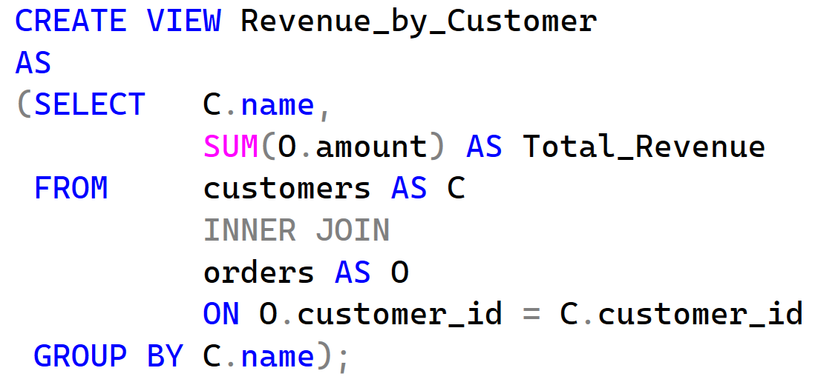
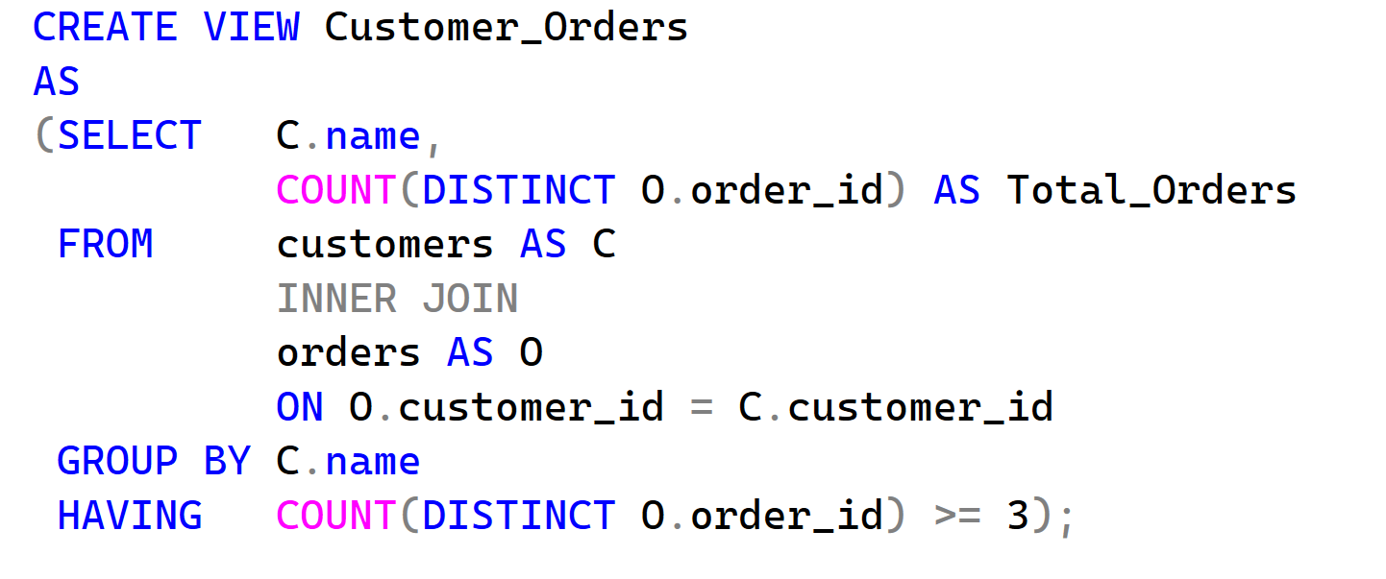
Questions
Total revenue by customer showing customer name and total revenue
Customers with at least 3 orders showing customer name and order count

Slide 4
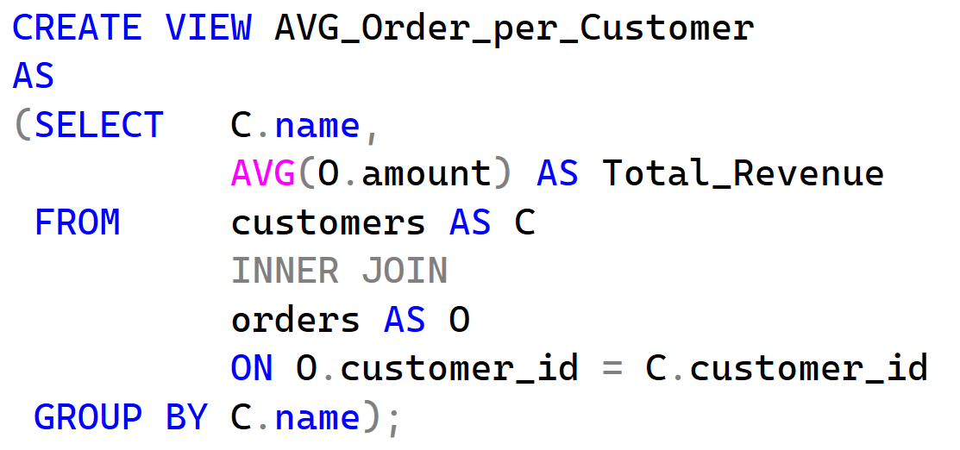
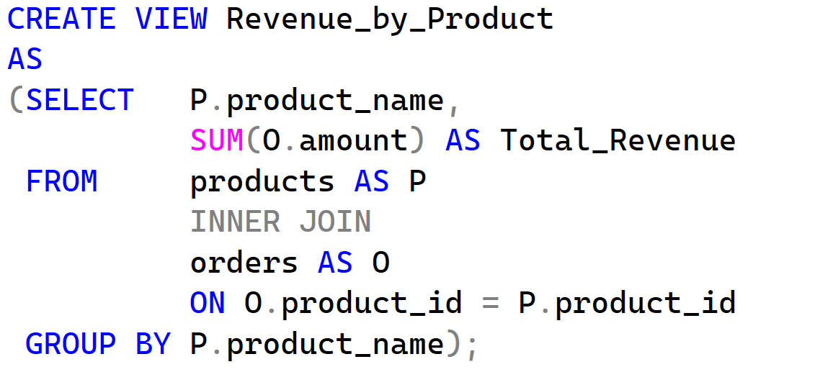
Questions
Average order value per customer showing customer name and average amount
Total revenue by product showing product name and total revenue

Slide 5
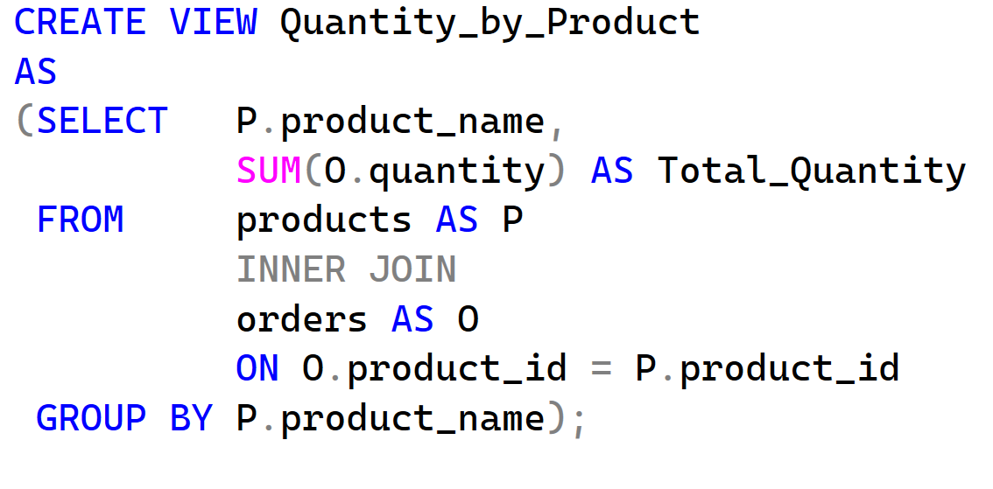
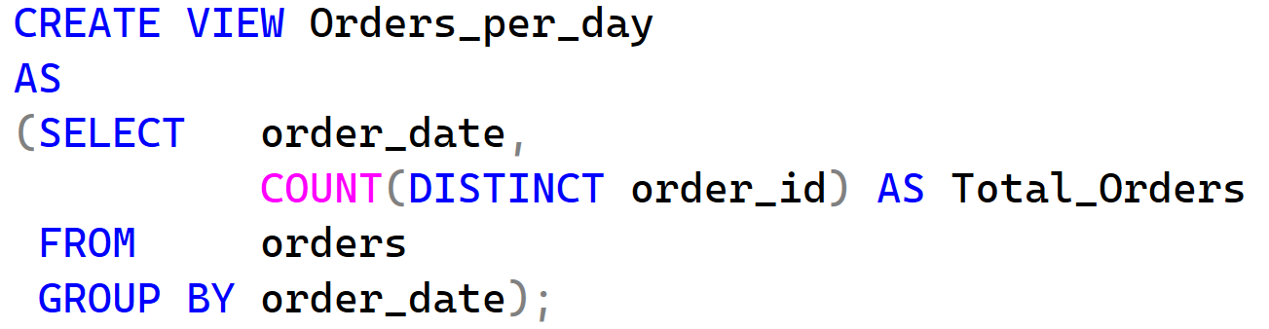
Questions
Total quantity sold by product showing product name and total quantity sold
Number of orders per day showing order date and order count

Slide 6
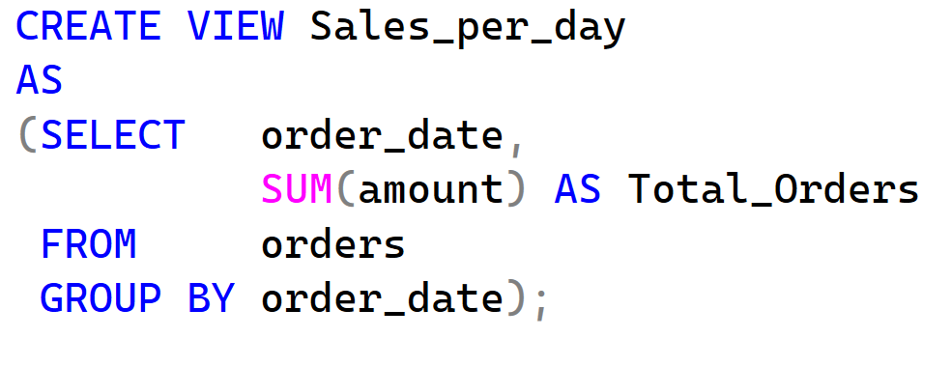
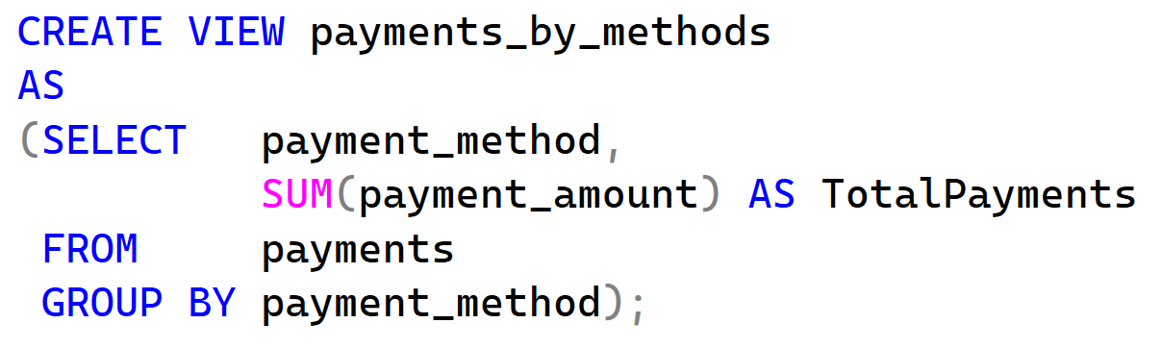
Questions
Total sales per day showing order date and daily sales amount
Total payments by payment method showing payment method and total collected

Slide 7
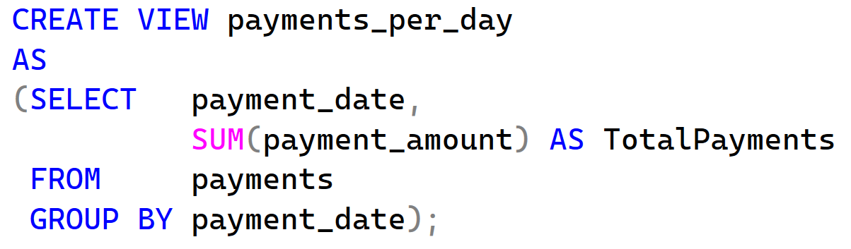
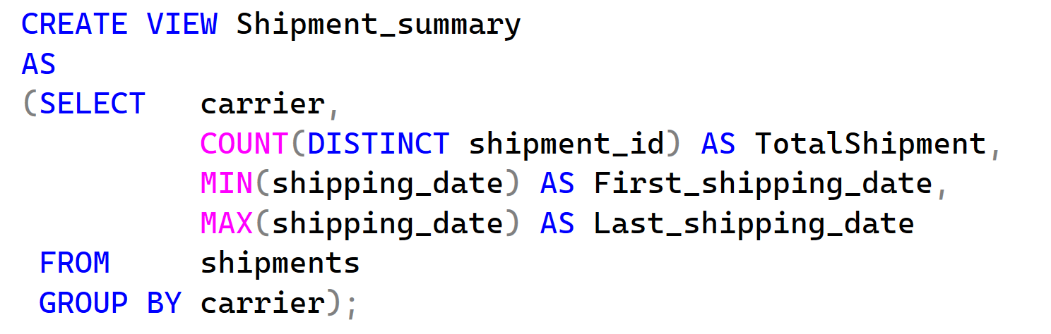
Questions
9. Total payments per day showing payment date and total payment amount
Shipment summary by carrier showing carrier name, shipment count, first shipping date, and last shipping date

Slide 8
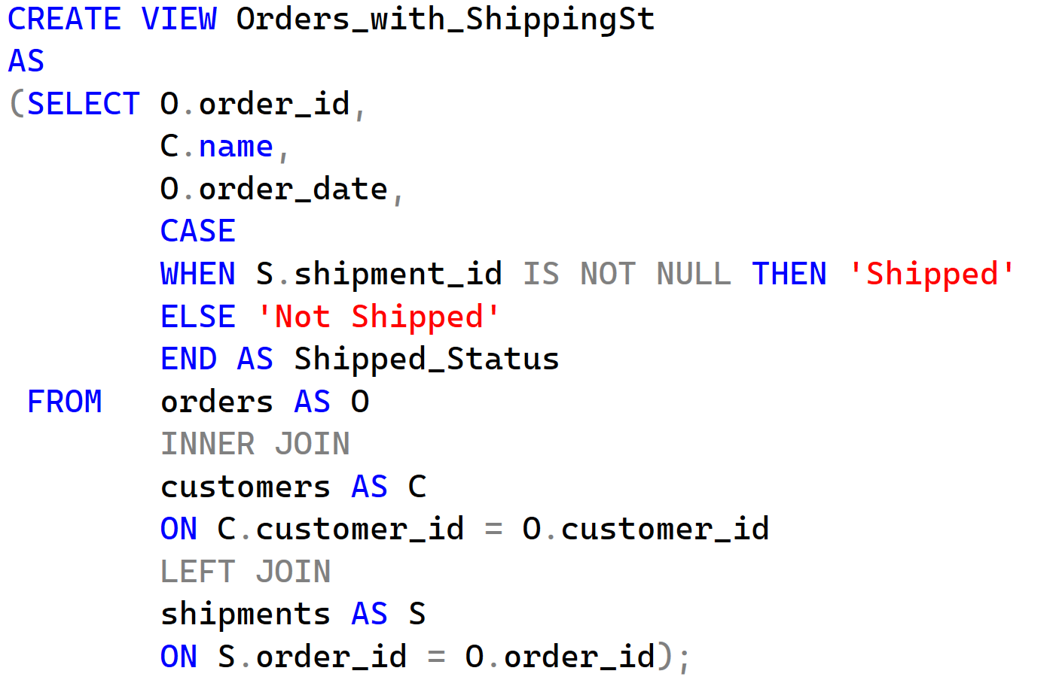
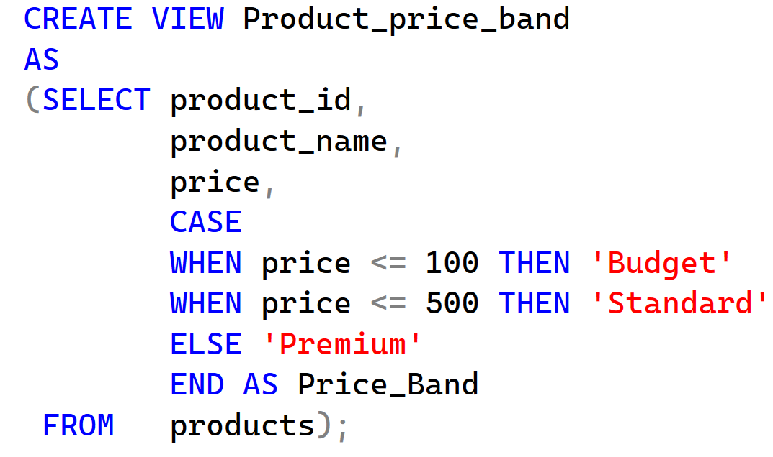
Bounce Problems
Orders with shipping status: order ID, customer name, order date, shipped_status (shipped / not_shipped)
Product price rank band: product name, price, price_band based on price (budget/standard/premium)

